Slide 1

Background
Convenience & Typo-Resist Help users fill Lab Order Info (including the list of tests), by Laboratory Order Entry No.
Notes:
We found out typos always happen when users input test code too fast.
This task is designed to solve this issue and prevent users insert the wrong test into a Lab Order.

Slide 2
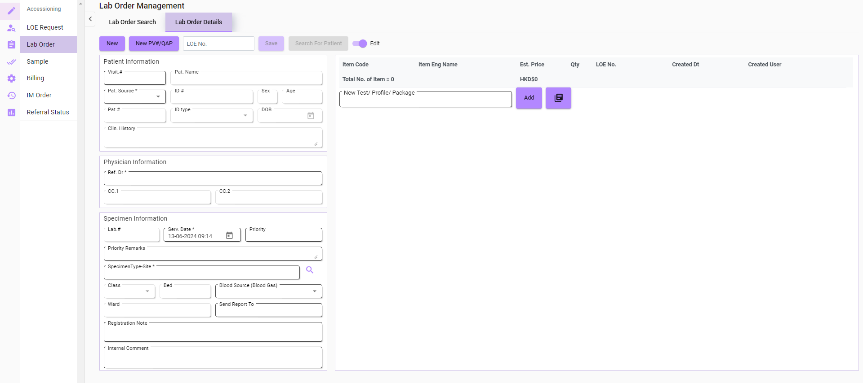
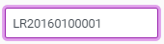
Input field
LOE No.
Notes:
On the Lab Order page, this is the new field I created for inputting LOE No.

Slide 3
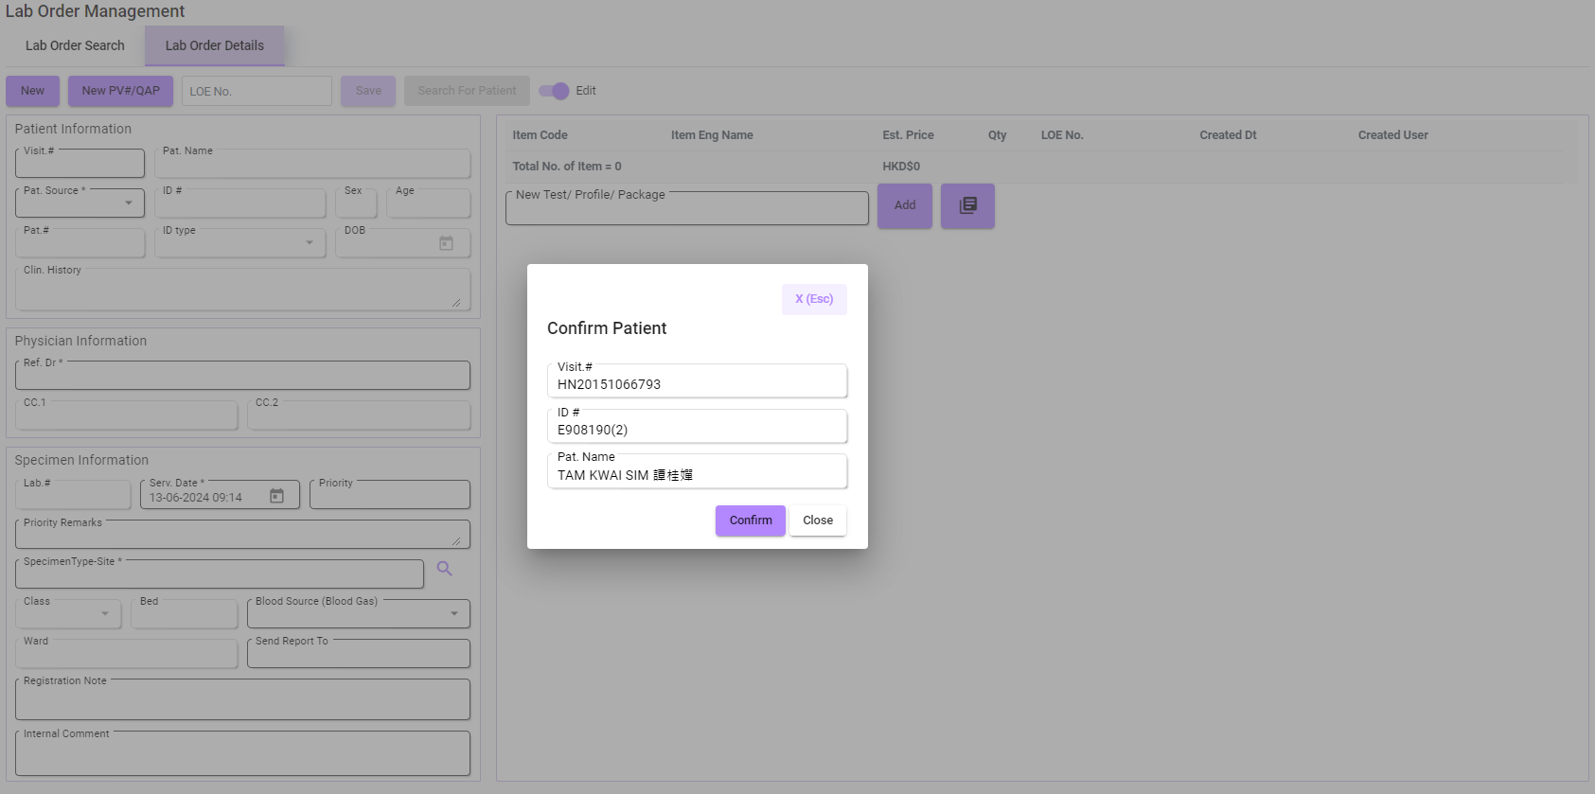
Notes:
The system will ask for a Patient Confirmation to ensure the user is targeting the correct patient.

Slide 4
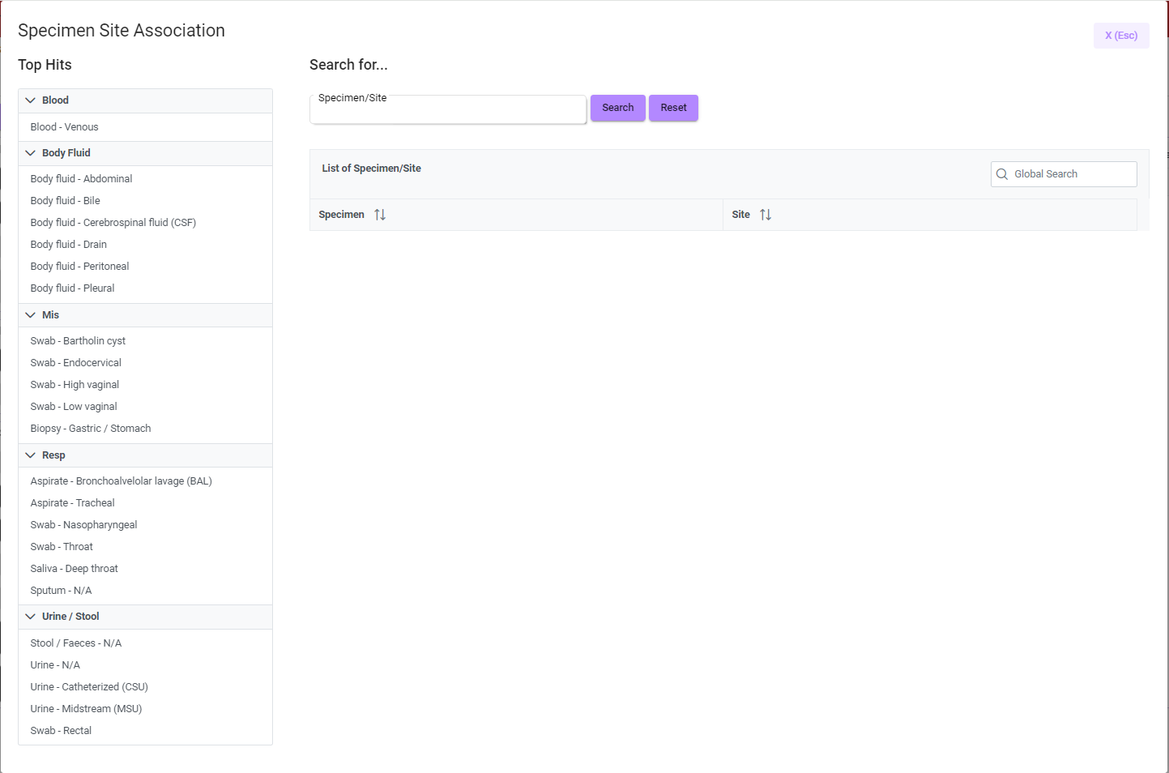
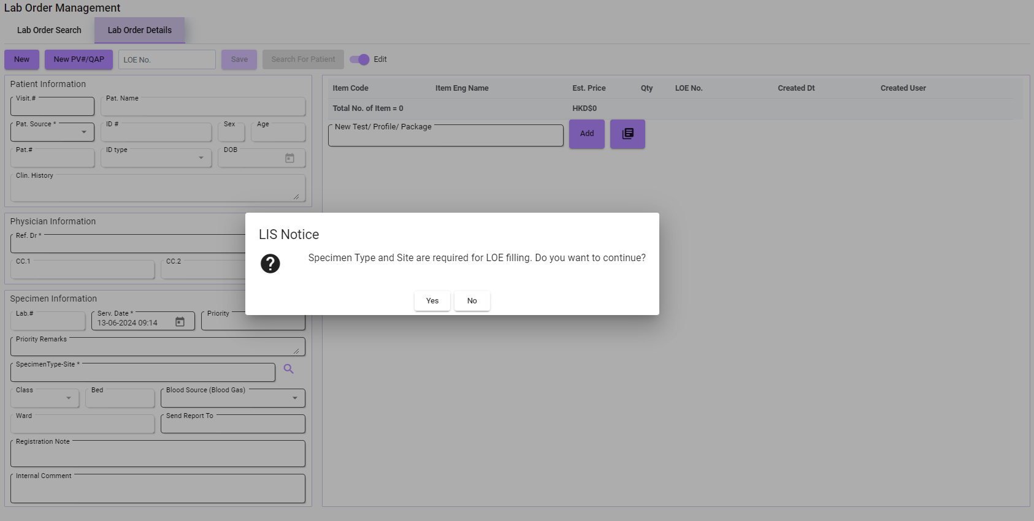
Notes:
After confirming, user will need to select the specimen type and site for the lab test insertion.
(tap)
Then, this screen will pop out for them to select. Let’s say we are doing Blood test this time.

Slide 5
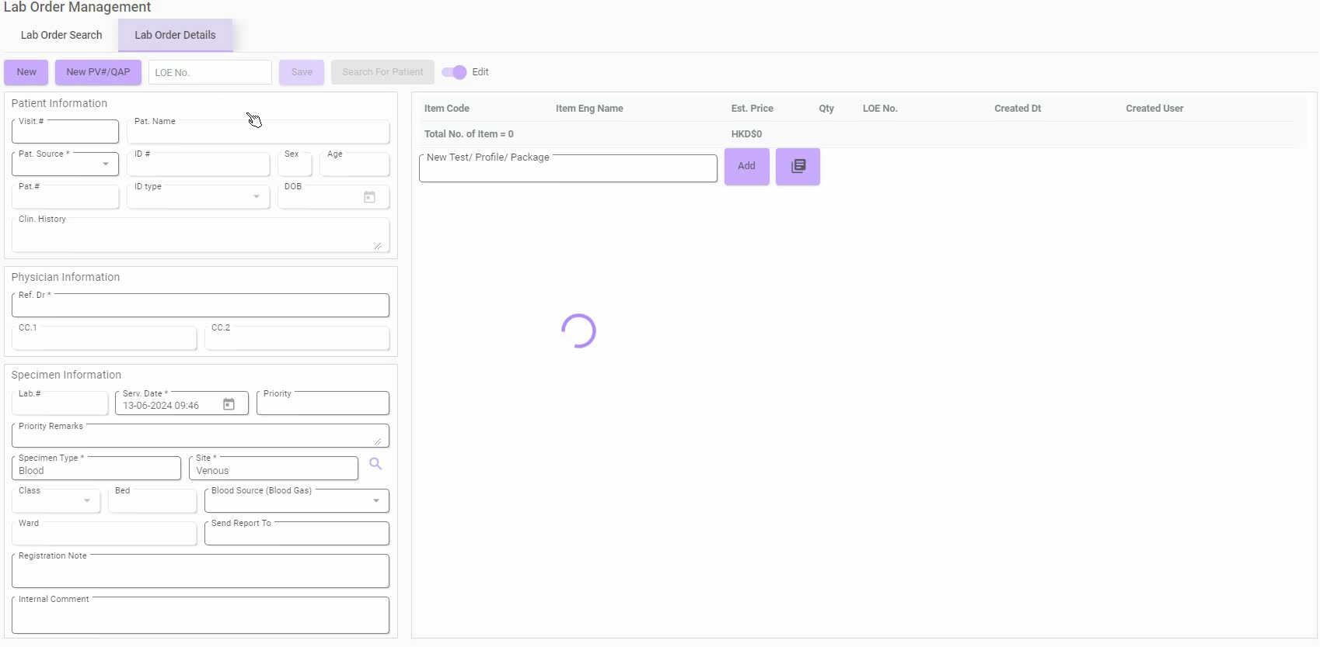
Notes:
After a while, the Lab Order information on the left side will be filled, and the test will be inserted one by one.

Slide 6
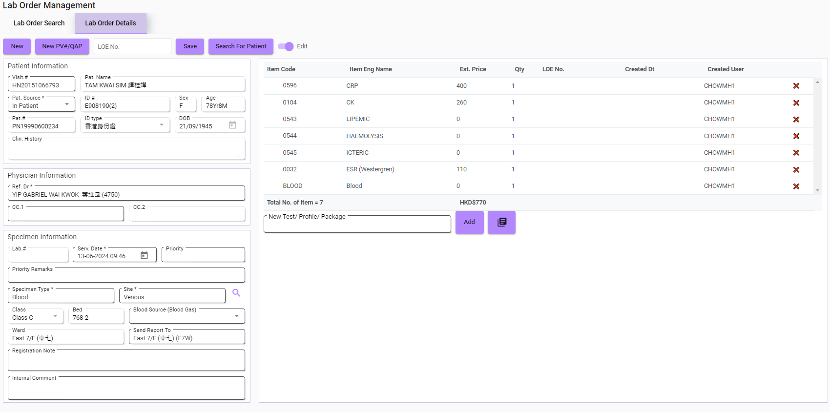
Same Patient Visit
Notes:
And, this is not the end yet.
Users can input a new LOE No. for the existing information. If the new No. is containing the record of the same Patient Visit.

Slide 7
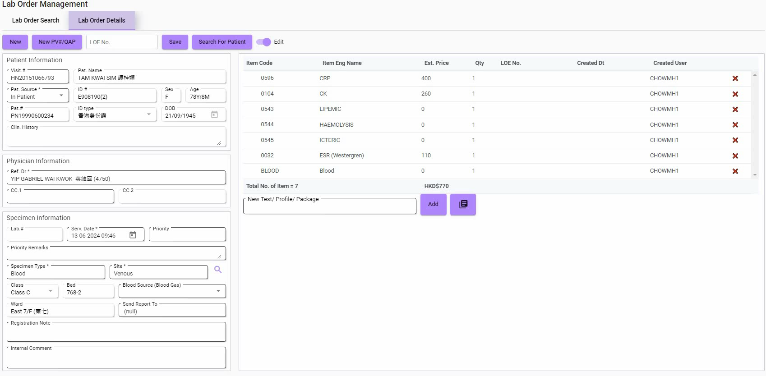
Notes:
Then, (tap) after confirming it’s the same patient, the new tests will be inserted into the existing test list.

Slide 8
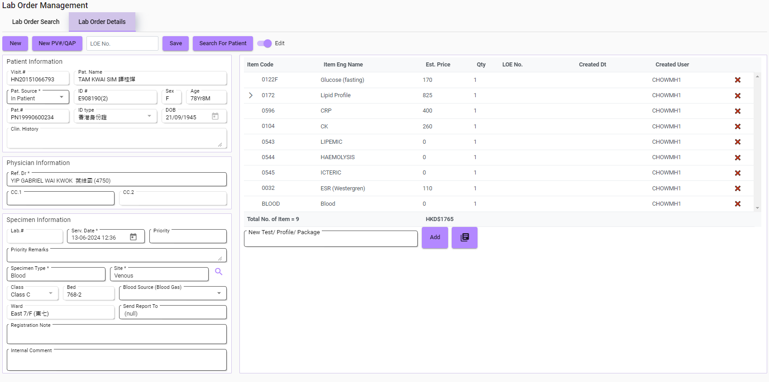
Different Patient Visit
Notes:
But if the LOE No. is containing records from a different Patient Visit.

Slide 9
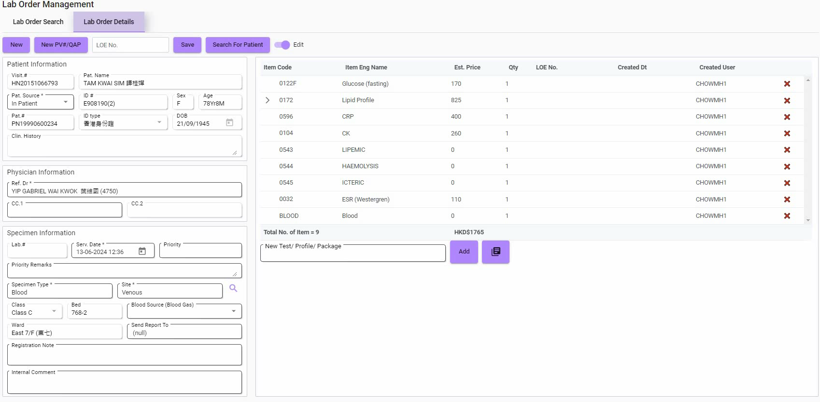
Notes:
Then, (tap) after confirming the patient, the auto-filling will be rejected to keep the current information.
So, this is the end of my report, Thank You!

